Slide 1

Web App Vulnerabilities & CTF
Let us hack around (see what I did there)

Slide 2
Agenda
Hi, my name is Mark… and I’m a …
OWASP Top 10
Some scary numbers
TryHackMe – SQL Injection
OWASP Juice Shop
Questions

Slide 3

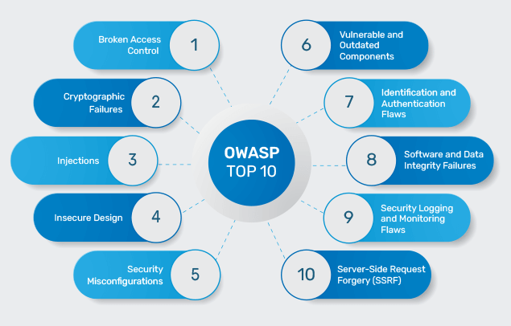
OWASP Top 10
The OWASP Top 10 is a list of the most critical security risks in web applications, published by the Open Web Application Security Project (OWASP). It helps developers, security teams, and organizations focus on the most common vulnerabilities that attackers exploit.

Slide 4
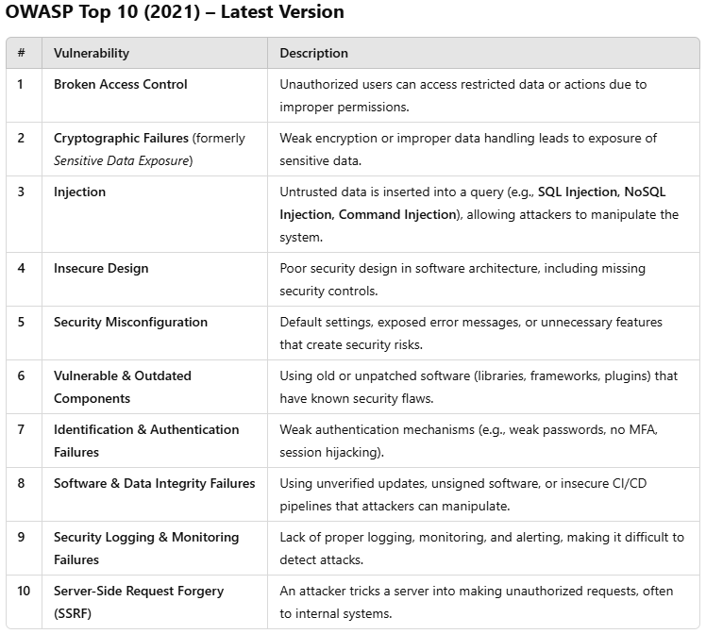

Slide 5
Some scary numbers.
Anthem Inc. Data Breach (2015): A significant SQL injection
vulnerability led to the exposure of personal information of
approximately 78.8 million individuals.
Adobe Systems Breach (2013): Weak authentication mechanisms resulted in unauthorized access, compromising nearly 153 million user records.
Equifax Breach (2017): An unpatched vulnerability in the Apache Struts framework led to the exposure of sensitive data of over 147 million consumers.
Capital One Breach (2019): A misconfigured Web Application Firewall (WAF) allowed unauthorized access, affecting over 100 million individuals.

Slide 6
TryHackMe – SQL Injection
Learn how to detect and exploit SQL Injection vulnerabilities.
What is SQL Injection – where user-provided data gets included in the SQL query itself, modifying the initial query. We’ll assume that we all know what SQL is, as well as Database / Tables /Data.
We’ll focus on Tasks 5 & 6.

Slide 7
OWASP Juice Shop
docker run --rm -p 127.0.0.1:3000:3000 bkimminich/juice-shop
Task 1
Find the admin email address and see if you can log in with their details. (Injection)
Task 2
Post a product review as another user or edit any user’s existing review. (Broken Access Control)
Task 3
Access the administration section of the store. (Broken Access Control)
Task 4
Access a confidential file. (Cryptographic Failure – Sensitive Data Exposure)
Task 5
Register as a user with administrator privileges. (Improper Input Validation – multiple Items in Top 10)

Slide 8
Links and References.
https://owasp.org/www-project-top-ten/
https://tryhackme.com/room/sqlinjectionlm
https://tryhackme.com/room/owaspjuiceshop
https://pwning.owasp-juice.shop/companion-guide/latest/part2/README.html
https://pwning.owasp-juice.shop/companion-guide/latest/part2/sensitive-data-exposure.html

